Slide 1
BusNama: Bus Reservation System
By:
Tejaswini Bandaru
Mayank Raj
Aditya Gautam Mishra

Slide 2
Problem Statement:
BusNama is created to meet the needs of online bus reservation system with the customer being able to :
Book From the existing list of buses which still have available seats
View From the existing tickets he/she has booked
Cancel Any particular ticket that has been booked
Admin will be able to :
Add
A bus into the database, which can be used for booking
View
The list of buses in the database
Cancel
Any of the existing buses

Slide 3
Tech Used:
Java 8 (base programming language)
Hibernate 2.1 (JPA implementation)
Spring framework (for creating webservices)
Spring Boot 2.1.9 (auto configuring)
Spring Data 2.1.9 (performing repository ops)
Spring Security & JWT 2.1.9 (access restriction)
MySQL 5.5.1 7(database storage)
Tomcat 8.5 (hosting server for MVC)
GIT 2.23.0 (DevOps VCS tool)
Maven 3.6.1 (DevOps tool- Build & manage project)
Postman 7.9.0 (for running RESTful service)
NodeJS 10.16.3 (Javascript Runtime Environment)
Angular 6 (framework to develop web apps)
VSCode 1.39 (to develop front end)
AWS (collection of cloud services)
Docker 18.06.1 (to containerize OS)

Slide 4
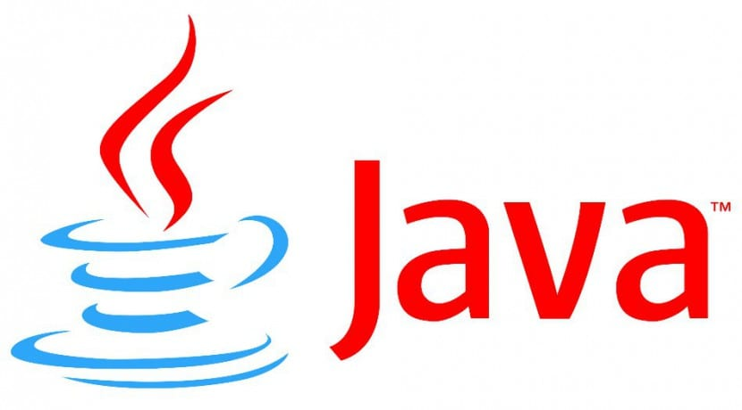
Java 8:
OOP advantage
Platform independence
Rich APIs

Slide 5

Hibernate 2.1:
For Object Relational
Mapping
Saving our entities into the database with ease
Handles object-relational impedance mismatch problems by replacing direct, persistent database accesses with high-level object handling functions

Slide 6
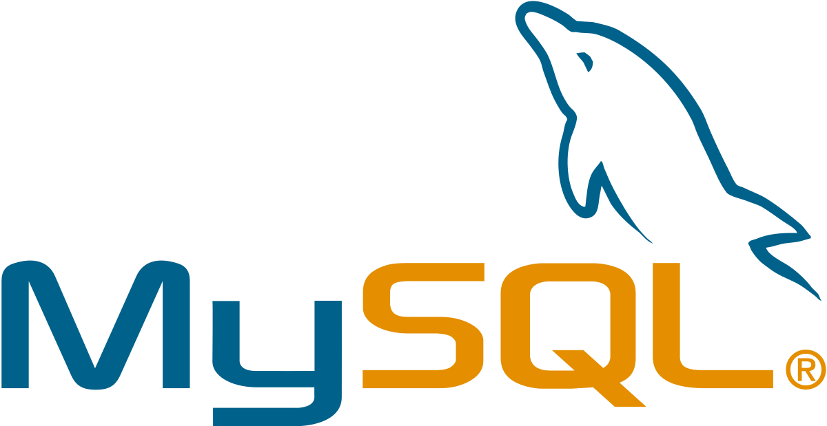
MySQL 5.5.17:
It is an open source database used to store our data.
It is a RELATIONAL DATABASE allowing data to be stored in a related format, thereby improving insertion, updation and deletion operations and reducing redundancy.

Slide 7

Tomcat v8.5:
It is used for HOSTING our application online, allowing users to interact via webpages.
Spring MVC framework is used to create web app.
MVC
Using this, we transmit data (Model) from webpage to Java application (Controller), process the data and return via webpages (View).

Slide 8

Spring Framework:
Spring Framework is an application framework and inversion of control container for the Java platform
Modules used:
Spring Core 2.1.9
Spring MVC 2.1.9
Spring Data 2.1.9
Spring Boot 2.1.9
Spring Security 2.1.9

Slide 9
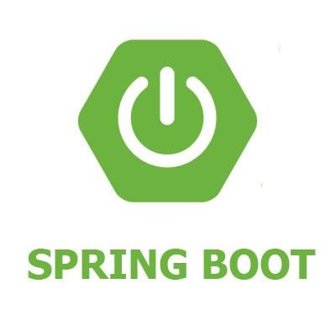
Spring Boot:
Spring's convention-over-configuration solution for creating stand-alone, production-grade Spring-based Applications that you can "just run"
Create stand-alone Spring applications
Embed Tomcat or Jetty directly (no need to deploy WAR files)
Provide opinionated 'starter' Project Object Models (POMs) to simplify your Maven configuration
Automatically configure Spring whenever possible
Provide production-ready features such as metrics, health checks and externalized configuration
Absolutely no code generation and no requirement for XML configuration

Slide 10
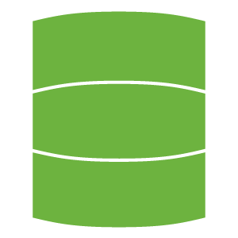
Spring Data:
Provides a familiar and consistent, Spring-based programming model for data access while still retaining the special traits of the underlying data store.
Powerful repository and custom object-mapping abstractions
Dynamic query derivation from repository method names
Implementation domain base classes providing basic properties
Support for transparent auditing (created, last changed)
Possibility to integrate custom repository code
Easy Spring integration via JavaConfig and custom XML namespaces
Advanced integration with Spring MVC controllers
Experimental support for cross-store persistence

Slide 11
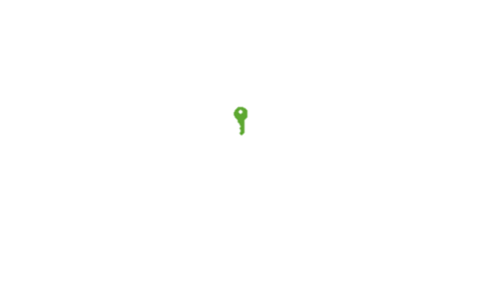


Spring Security & JWT:
Spring Security is a powerful and highly customizable authentication and access-control framework.
Comprehensive and extensible support for both Authentication and Authorization
Protection against attacks like session fixation, clickjacking, cross site request forgery, etc
Servlet API integration
Optional integration with Spring Web MVC
JSON Web Tokens are an open, industry standard RFC 7519 method for representing claims securely between two parties.
It can be used for an authentication system and can also be used for information exchange.

Slide 12
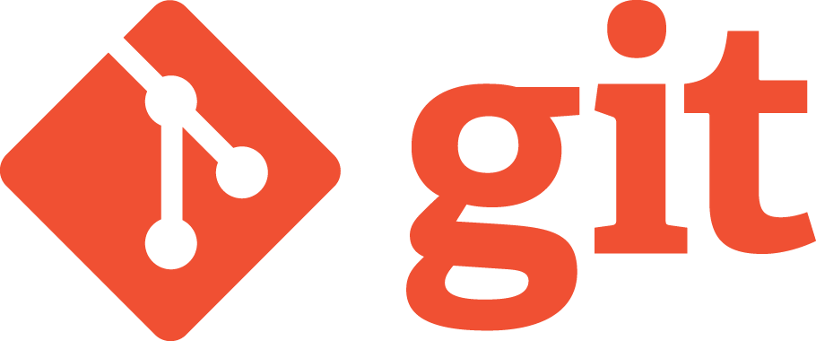
GIT:
It is a distributed version-control system for tracking changes in source code during software development. It is, but it can be. Its goals include speed, data integrity, and.
Designed for coordinating work among programmers
Used to track changes in any set of files
Support for distributed, non-linear workflows

Slide 13
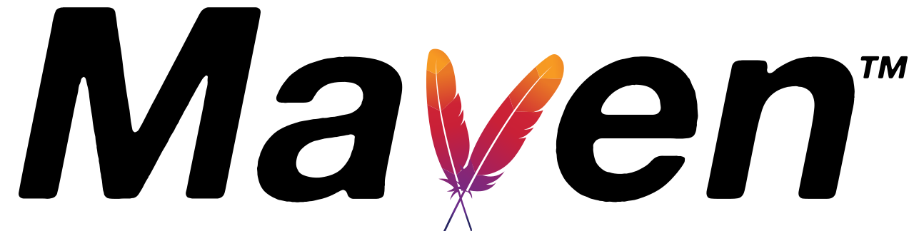
Maven 3.6.1:
It is a project management and comprehension tool that provides developers a complete build lifecycle framework.
Making the build process easy
Providing a uniform build system
Providing quality project information
Providing guidelines for best practices development
Allowing transparent migration to new features

Slide 14
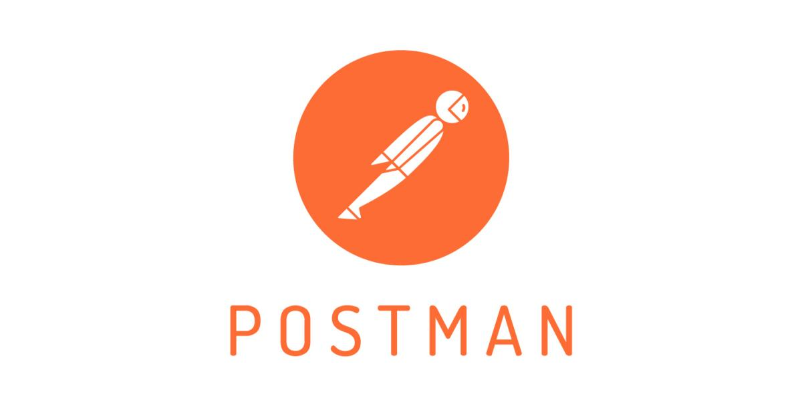
Postman 7.9.0:
Create and save REST, SOAP, and GraphQL queries directly
RESTful web services are light weight, highly scalable and maintainable and are very commonly used to create APIs for web-based applications. It also:
Provides access to resources and REST client accesses and modifies the resources
Resource is identified by URIs/ global IDs
Uses various representation to represent a resource like text, JSON, XML

Slide 15

NodeJS 10.16.3:
Open-source, cross-platform, JavaScript runtime environment that executes JavaScript code outside of a browser.
Uses an event-driven, non-blocking I/O model that makes it lightweight and efficient, perfect for data-intensive real-time applications that run across distributed devices.

Slide 16
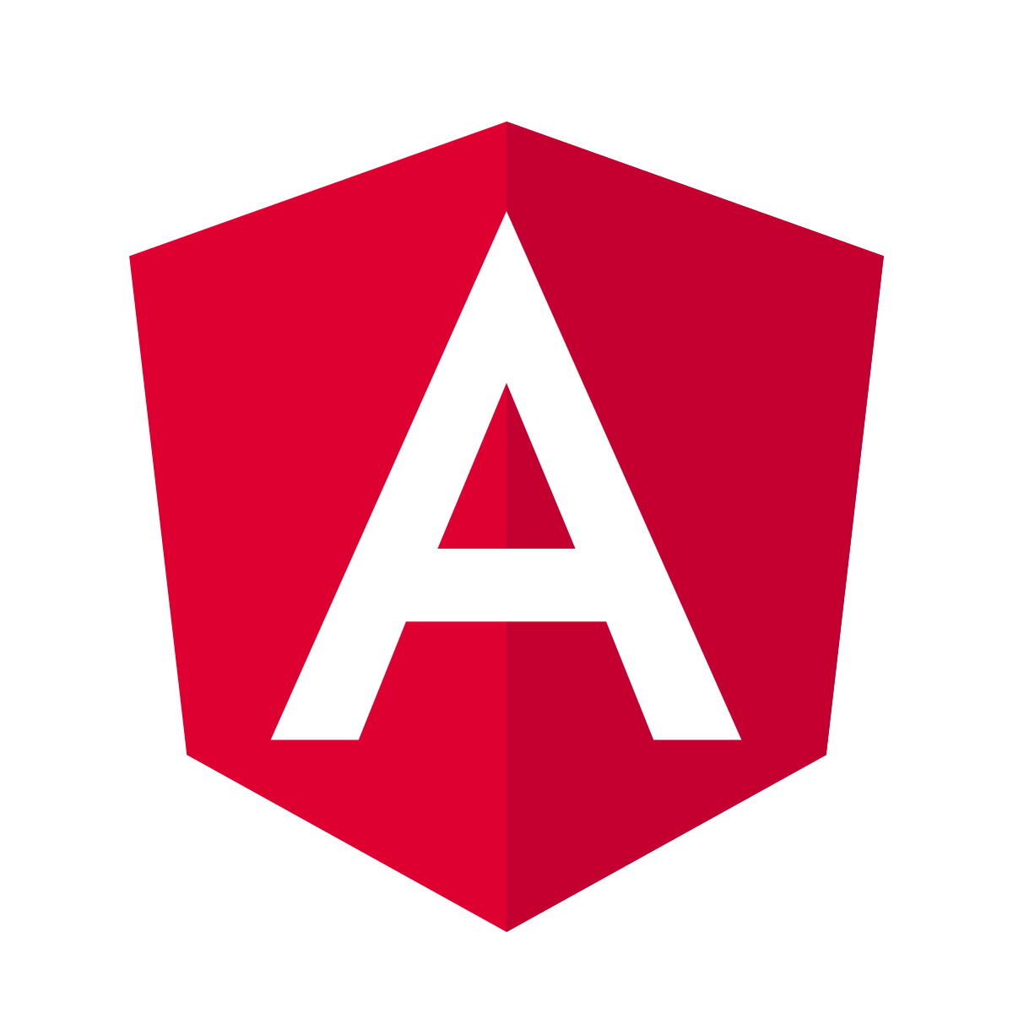
Angular 6:
TypeScript-based open-source web application framework for building mobile and desktop web applications.
Lets you use HTML as your template language and lets you extend HTML's syntax to express your application's components clearly and succinctly

Slide 17
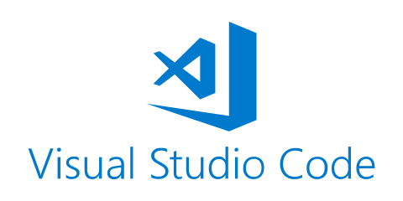
VS Code 1.39:
Source code editor developed by Microsoft, includes support for debugging, embedded GIT control, syntax highlighting, intelligent code completion, snippets.

Slide 18

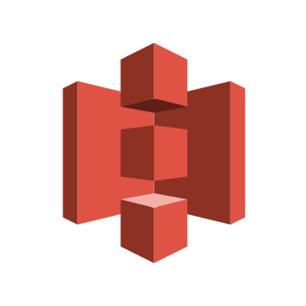
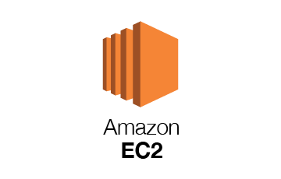

AWS
Amazon Web Services utilized:
EC2 - Instance of Cloud Server
RDS - Cloud Database
S3 - Cloud Storage
Amazon RDS
Amazon S3

Slide 19

Docker 18.06.1
Docker is an open platform for developing, shipping, and running applications. Docker enables you to separate your applications from your infrastructure so you can deliver software quickly.

Slide 20
Plan:
Design
Identify classes & Interfaces
Identify attributes & methods
Creating the Layers
Making independent layers
Modular approach
TDD approach
Identify test cases for each module
Write Failing Test cases
Convert the Test Cases in GREEN
Implement the phases in incremental manner

Slide 21
Modules:
Admin
Customer

Slide 22
Admin Module:
Add Bus
Show Buses
Delete Bus
Show Users

Slide 23
Customer Module:
Show Tickets Left
Show Bookings
Cancel Booking
Create Booking
Show Booking Details
Add Passenger

Slide 24
Meet the team:
Tejaswini-
Customer story lead.(UI, Validation, Controller, Service, Backend, Angular Customer Story)
Has implemented Spring Security in the project. Created the Class Diagram.
Aditya-
Admin story lead.(UI, Validation, Controller, Service, Backend, Angular Admin Story)
Has implemented Logger, Audit Trail, Exception handling. Worked on the Presentation & Use Case Diagram and Front end Bootstrap.
Mayank-
User story lead.(UI, Validation, Controller, Service, Backend, Testing)
Has created the Activity Diagram, ER Diagram.

Slide 25



Questions, if any.
Yet to implement AWS.

Slide 26
Thank You

